Slide 1
EdgeWise: A Better Stream Processing Engine
for the Edge
Xinwei Fu, Talha Ghaffar, James C. Davis, Dongyoon Lee
Department of Computer Science

Slide 2










Edge Stream Processing
Internet of Things (IoT)
Things, Gateways and Cloud
Edge Stream Processing
Gateways process continuous streams of data in a timely fashion.
Things
Gateways
Cloud
city
hospital
Edge Stream Processing
Central Analytics
sensors
actuators

Slide 3

Our Edge Model
Hardware
Limited resources
Well connected
Application
Reasonable complex operations
For example, FarmBeats [NSDI’17]
Things
Gateways
Cloud
city
hospital
Edge Stream Processing
Central Analytics
sensors
actuators

Slide 4
Edge Stream Processing Requirements
Multiplexed - Limited resources
No Backpressure - latency and storage
Low Latency - Locality
Scalable - millions of sensors
Things
Gateways
Cloud
city
hospital
Edge Stream Processing
Central Analytics
sensors
actuators

Slide 5
Dataflow Programming Model
Topology - a Directed Acyclic Graph
Deployment
Describe # of instances for each operation
source sink
operation data flow
Things
Gateways
Cloud
city
hospital
Edge Stream Processing
Central Analytics
sensors
actuators
Running on PIs

Slide 6
Runtime System
Stream Processing Engines (SPEs):
Apache Storm
Apache Flink
Apache Heron
Topology
0
1
2
3
Worker 2
One-Worker-per-Operation-Architecture
Queue and Worker thread
Pipelined manner
OWPOA
Q2
Worker 0
Worker 1
sink
Q0
Q1
operation 2
Backpressure
- latency
- storage
src
Worker 3
Q3
operation 0
operation 1
operation 4
sink

Slide 7


Problem
Existing One-Worker-per-Operation-Architecture Stream Processing Engines are not suitable for the Edge Setting!
___Scalable ___Multiplexed ___Latency ___Backpressure
OWPOA SPEs
Cloud-class resources
OS scheduler
Edge
Limited resources
# of workers >> # of CPU cores
Inefficiency in OS scheduler
Low input rate → Most queues are empty
High input rate → Most or all queues contain data
→ Scheduling Inefficiency
→ Backpressure
→ Low Latency

Slide 8
Problem
Existing One-Worker-per-Operation-Architecture Stream Processing Engines are not suitable for the Edge Setting!
___Scalable ___Multiplexed ___Latency ___Backpressure
Q0
3
OP0
3
3
#
4
#
processing
4
de-scheduled
Q1
2
OP1
1
1
3
1
2
#
idle
time
4
OWPOA – Random OS Scheduler

Slide 9
EdgeWise
Key Ideas:
Topology
0
1
2
# of workers >> # of CPU cores
→ A fixed-sized worker pool
3
Inefficiency in OS scheduler
→ Engine-level scheduler
EdgeWise
worker pool
(fixed-size workers)
src
scheduler
Q0
Q1
operation 1
___Scalable ___Multiplexed
___Latency ___Alleviate Backpressure
Q2
Q3
operation 3
sink

Slide 10
EdgeWise – Fixed-size Worker Pool
Fixed-size Worker Pool
# of worker = # of cores
Support an arbitrary topology on limited resources
Reduce overhead of contending cores
Topology
0
1
2
3
EdgeWise
worker pool
(fixed-size workers)
src
scheduler
Q0
Q1
operation 1
___Scalable ___Multiplexed
___Latency ___Alleviate Backpressure
Q2
Q3
operation 3
sink

Slide 11
EdgeWise – Engine-level Scheduler
A Lost Lesson: Operation Scheduling
Profiling-guided priority-based
Multiple OPs with a single worker
Topology
0
1
2
3
Carney [VLDB’03]
Min-Latency Algorithm
Higher static priority on latter OPs
EdgeWise
worker pool
(fixed-size workers)
src
scheduler
Q0
Babcock [VLDB’04]
Min-Memory Algorithm
Higher static priority on faster filters
Q1
operation 1
Q2
Q3
operation 3
sink
We should regain the benefit of the engine level operation scheduling!!!

Slide 12
EdgeWise – Engine-level Scheduler
Congestion-Aware Scheduler
Profiling-free dynamic solution
Balance queue sizes
Choose the OP with the most pending data.
Q0
4
4
OP0
3
#
processing
3
de-scheduled
Q1
2
1
OP1
1
2
2
3
#
idle
time
EdgeWise – Congestion-Aware Scheduler
___Scalable ___Multiplexed ___Latency ___Alleviate Backpressure

Slide 13
Performance Analysis using Queueing Theory
Novelty:
To the best of our knowledge, we are the first to apply queueing theory to analyze the improved performance in the context of stream processing.
Conclusion 1:
Maximum end-to-end throughput depends on scheduling heavier operations proportionally more than lighter operations.
Conclusion 2:
A data waits longer in the queues of heavier operations, and crucially the growth in wait time is non-linear.
By balancing queue sizes, EdgeWise achieves Higher Throughput and Lower Latency than One-Worker-per-Operation-Architecture.
See our paper for more details.

Slide 14
Evaluation
Implementation:
On top of Apache Storm v1.1.0
Hardware:
Raspberry Pi 3
Baseline:
OWPOA baseline – Apache Storm
Schedulers:
- Random - Min-Memory - Min-Latency
Experiment Setup:
Focus on a single raspbi 4 cores --> a pool of 4 worker threads
Benchmarks:
RIoTBench - a real-time IoT stream processing benchmark for Storm.
PRED
O2
Decision Tree
O1
O3
O4
O6
Source
SenML
Parse
Linear
Reg.
Error
Est.
MQTT
Publish
Metrics:
Throughput & Latency
O5
Average

Slide 15
Throughput-Latency Performance
PRED topology Throughput-Latency

Slide 16
Fine-Grained Latency Analysis
PRED Latency break down in Storm
PRED Latency break down in EdgeWise
Conclusion 2:
A data waits longer in the queues of heavier operations, and crucially the growth in wait time is non-linear.

Slide 17
Conclusion
Study existing SPEs and discuss their limitations in the Edge
EdgeWise
-- a fixed-size worker pool
-- an congestion-aware scheduler
-- a lost lesson of operation scheduling
Performance analysis of the congestion-aware scheduler using Queueing Thoery
Up to 3x improvement in throughput while keeping latency low
Thank you for listening!
I am waiting for your questions!

Slide 18
Backup Slides

Slide 19
Problem
Existing OWPOA SPEs are not suitable for the Edge Setting!
___Scalable ___Multiplexed ___Latency ___No Backpressure
# of instance of each operation can be assigned during the deployment
Topology
0
1
2
3

Slide 20
Performance Analysis using Queueing Theory
Novelty:
To the best of our knowledge, we are the first to apply queueing theory to analyze the improved performance in the context of stream processing.
Prior scheduling works in stream processing either provide no analysis or focus only on memory optimization.

Slide 21
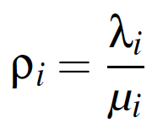
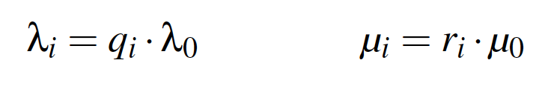
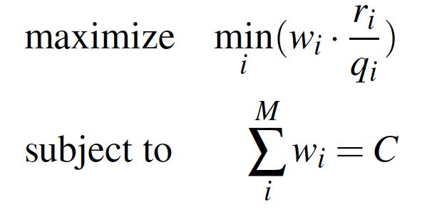
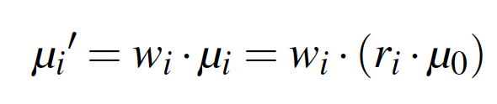
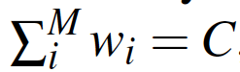
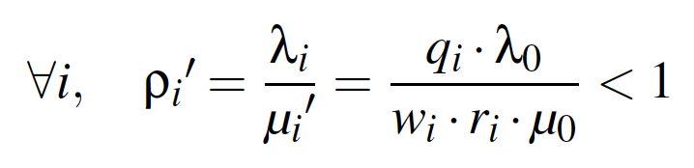
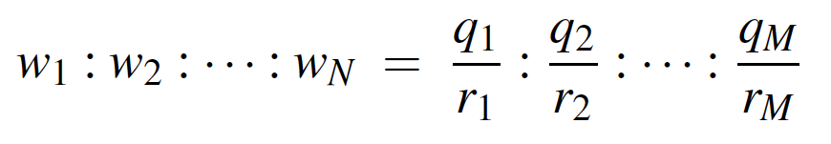
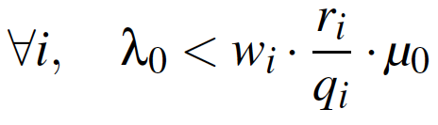
Performance Analysis using Queueing Theory
Conclusion 1:
Maximum end-to-end throughput depends on scheduling heavier operations proportionally more than lighter operations.
Input rate
Service rate
Utilization
Scheduling weight
Effective service rate
==>>
Stable constraint
scheduling weight -> input rate / service rate
==>>

Slide 22
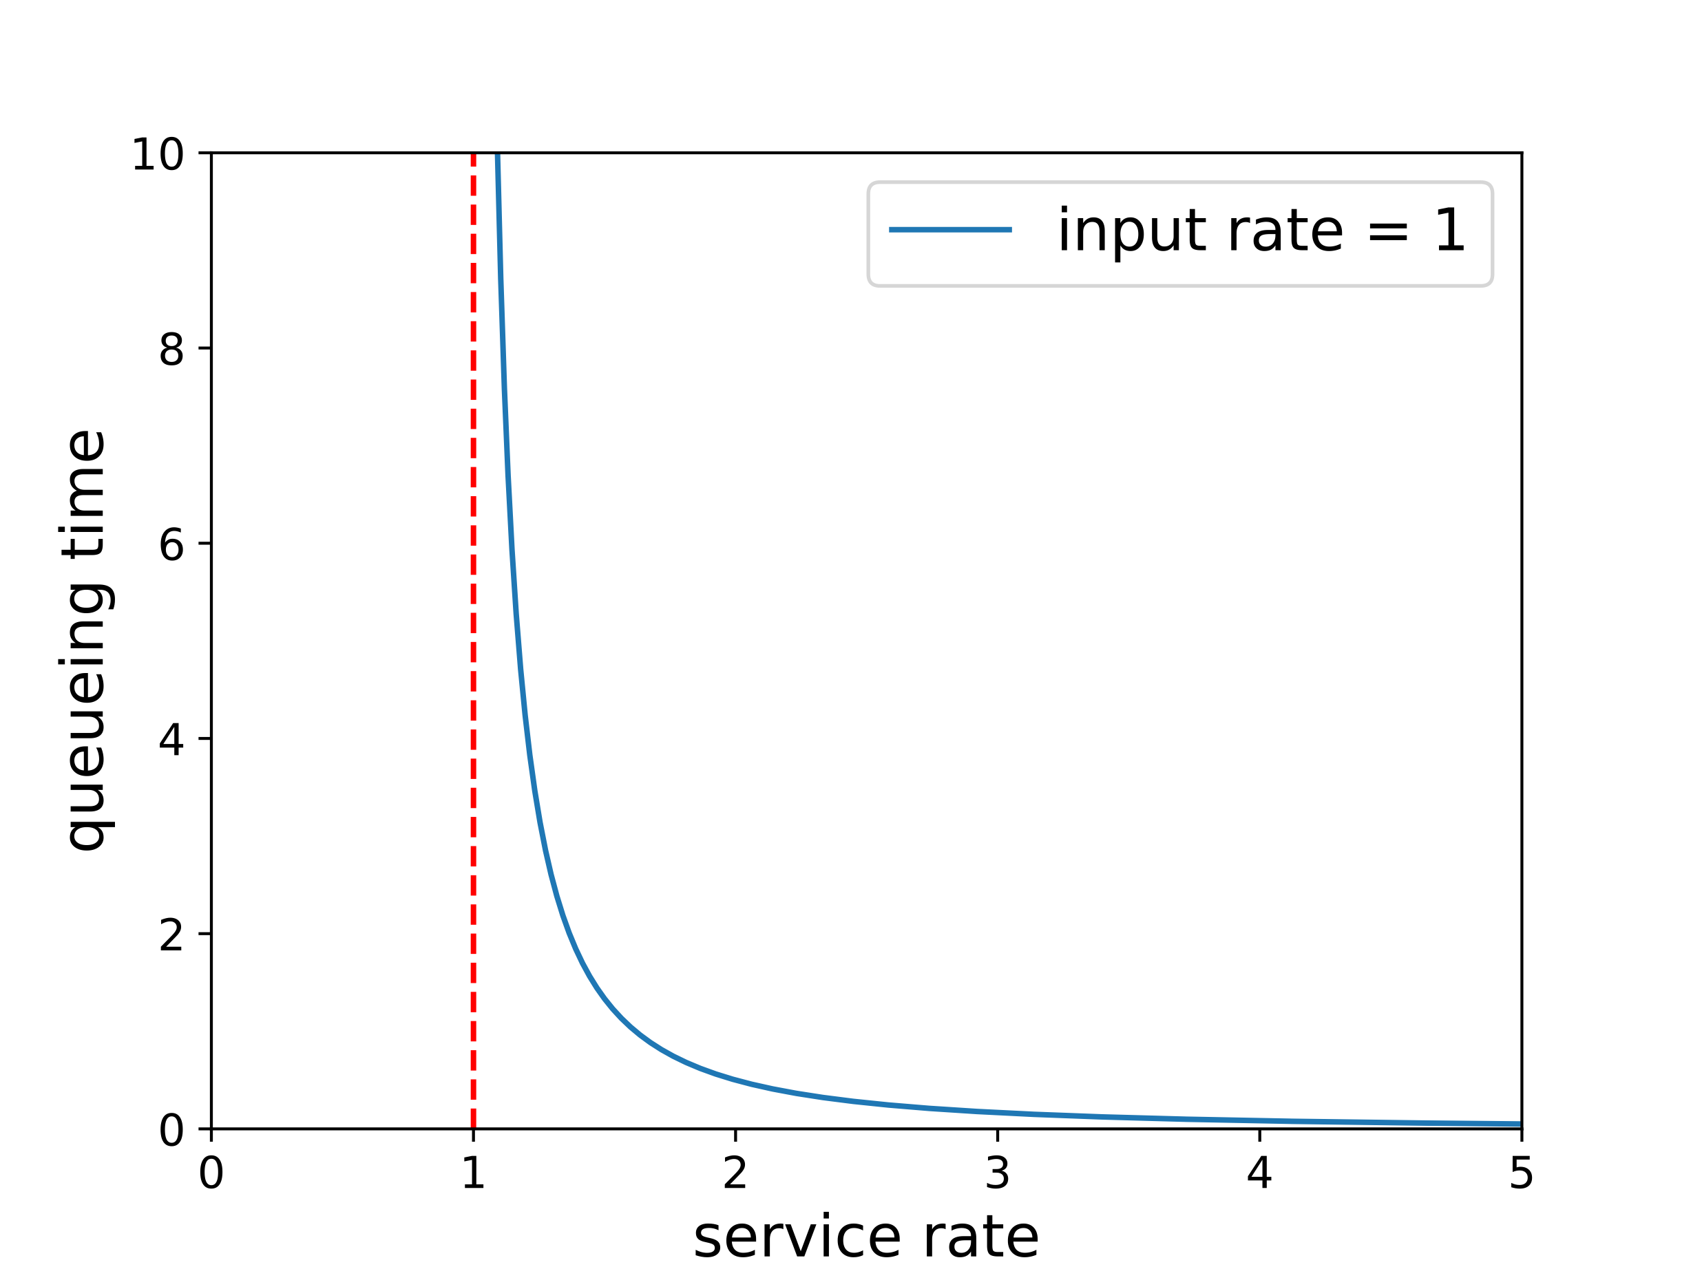
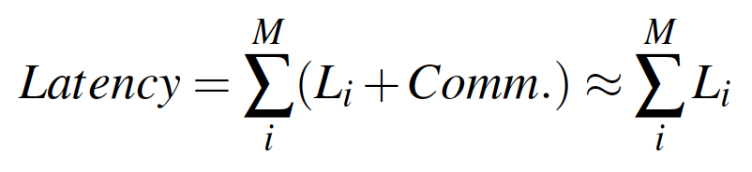
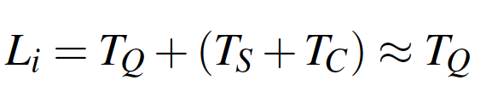
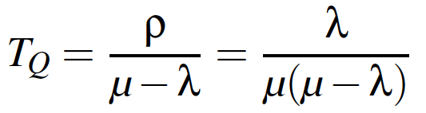
Performance Analysis using Queueing Theory
Conclusion 2:
A data waits longer in the queues of heavier operations, and crucially the growth in wait time is non-linear.
End-to-end latency
Per-operation latency
Queueing time – waiting in the queue
(using exponential distribution)

Slide 23
Evaluation
Benchmarks:
RIoTBench - a real-time IoT stream processing benchmark for Storm
Modification: a timer-based input generator.
Metrics:
- Throughput - Latency

Slide 24
Throughput-Latency Performance
PRED
TRAIN
ETL
STATS

Slide 25
Fine-Grained Throughput Analysis
In PRED, as the input rate (throughput) increase, the coefficient of variation (CV) of operation utilization grows in Storm, but it decreases in EdgeWise
Conclusion 1:
Maximum end-to-end throughput depends on scheduling heavier operations proportionally more than lighter operations.

Slide 26
Data Consumption Policy
Sensitivity study on various consumption policies with STATS topology

Slide 27
Performance on Distributed Edge
PRED: maximum throughput achieved with the latency less than 100 ms

Slide 28
Limitations
I/O bound computation:
The preferred idiom is outer I/O, inner compute
Worker pool size could be tuned
I/O could be done elsewhere, like Microsoft Bosque

Slide 29
Icon Credit
Icon credit for www.flaticon.com

